Slide 1
Docker and Kubernetes

Slide 2
Docker
Introduction to docker, images and containers

Slide 3
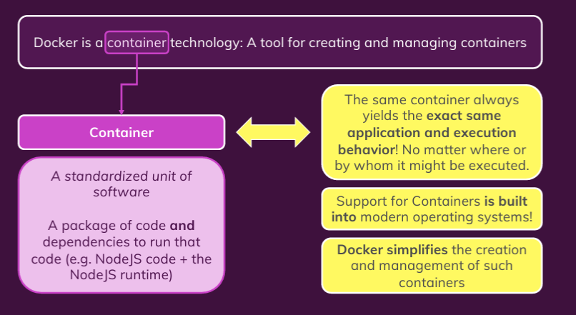
What is and Why Docker?

Slide 4
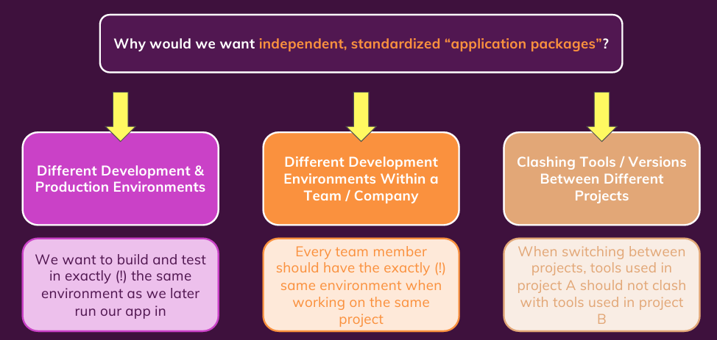
Why Containers?

Slide 5
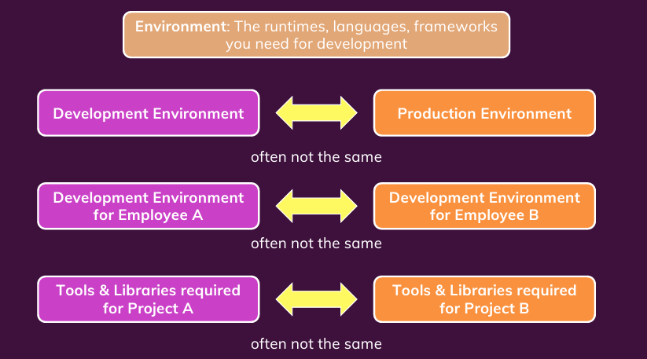
Problems Without Container

Slide 6
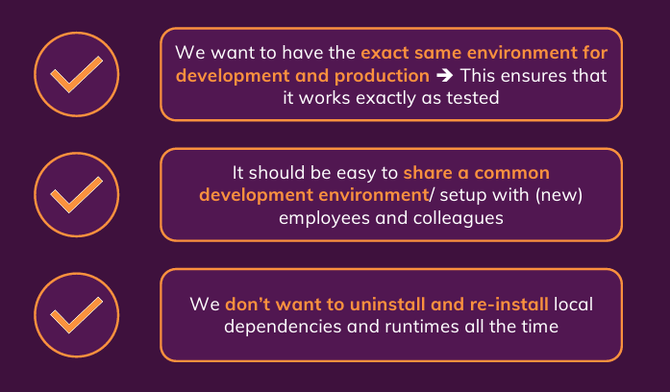
What you need as solution?

Slide 7
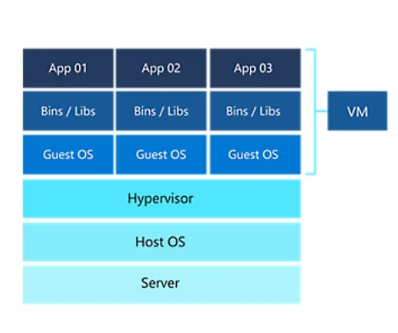
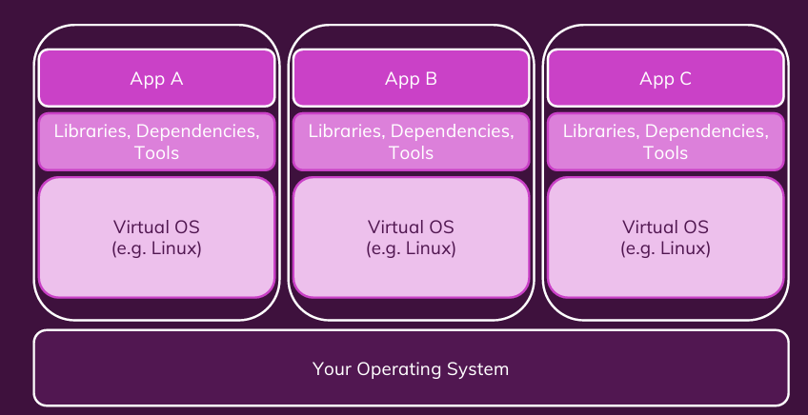
Virtual Machines

Slide 8
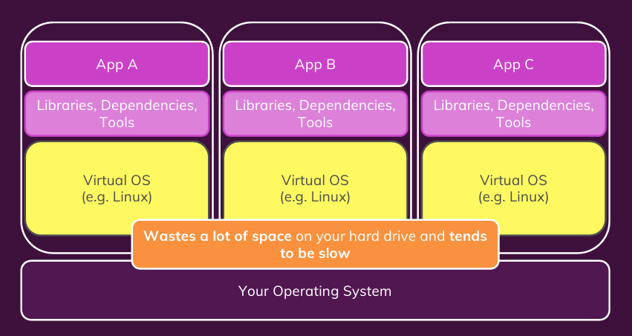
Disadvantages of VM

Slide 9
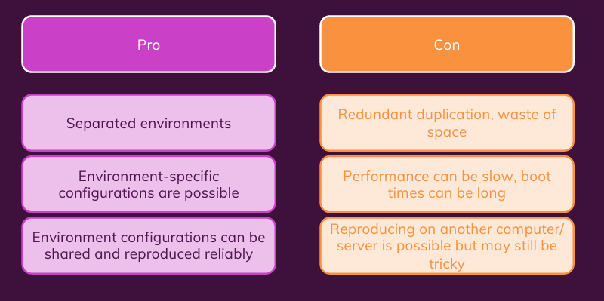
VM: Pros and Cons

Slide 10
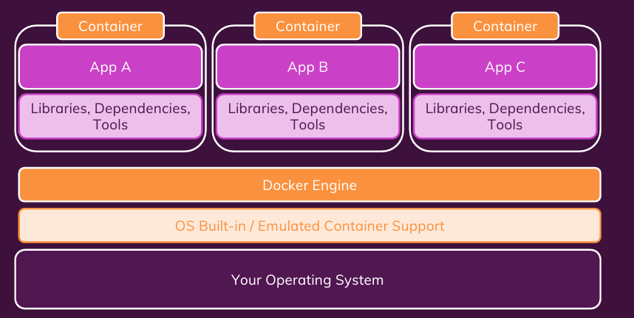
Docker Helps You Manage Containers

Slide 11
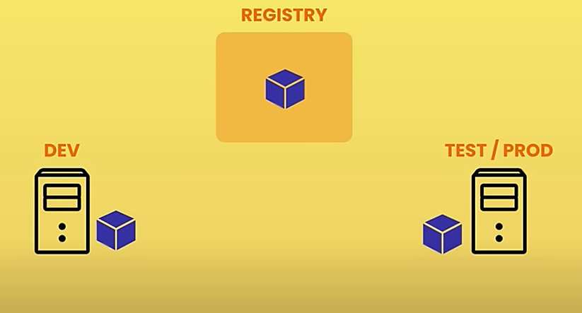
Build and Share Image

Slide 12
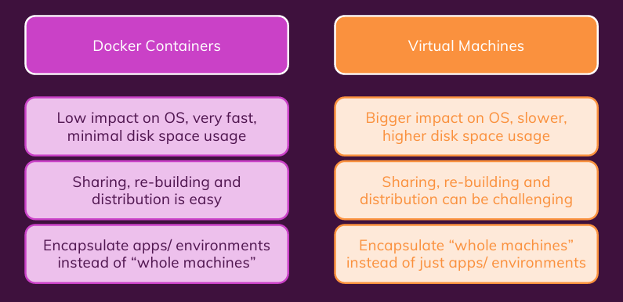
Docker Containers Vs VMs

Slide 13
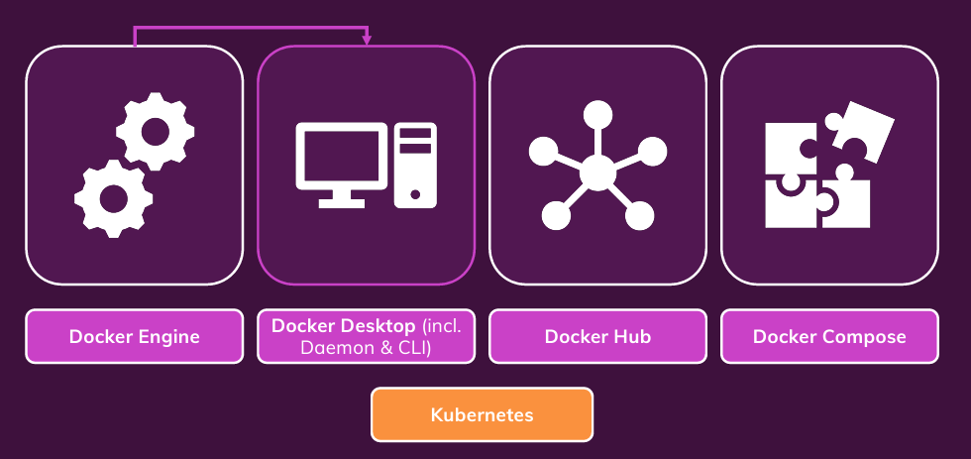
Docker Tools and Building Blocks

Slide 14
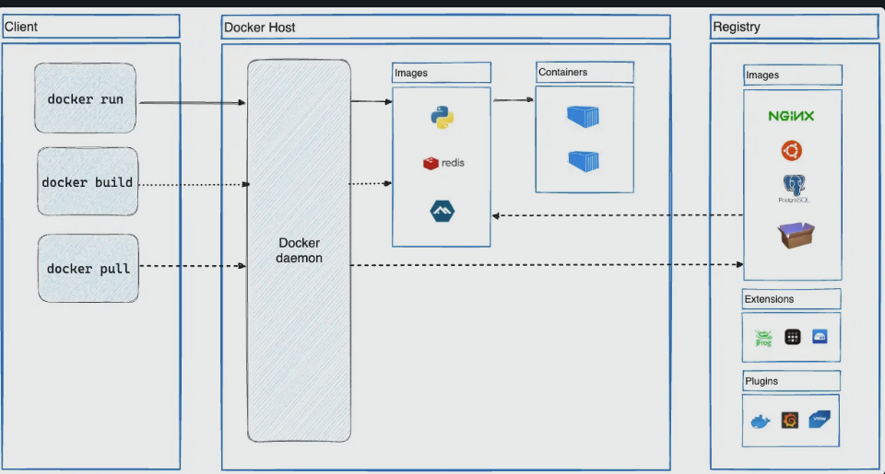
Docker Archtecture

Slide 15
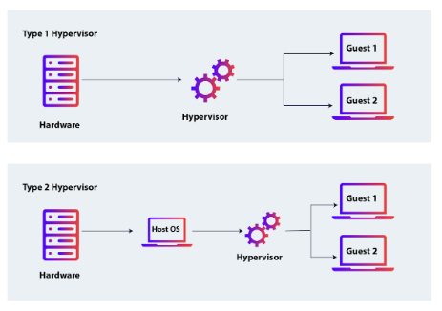
Types of Hypervisor

Slide 16
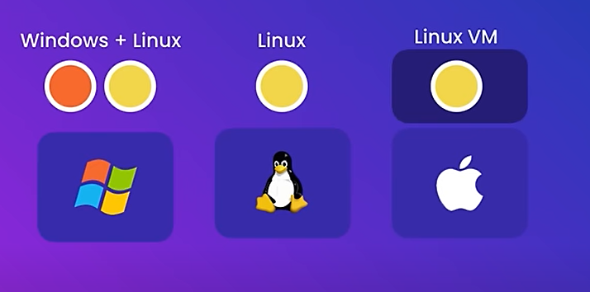
Docker on different O/S

Slide 17
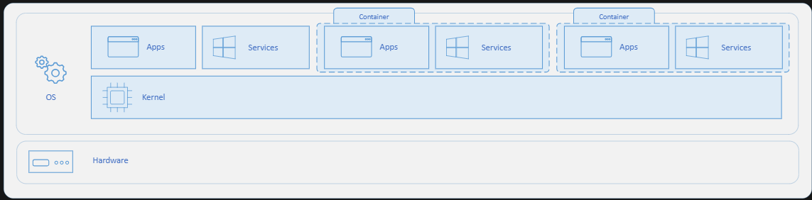
How containers work

Slide 18
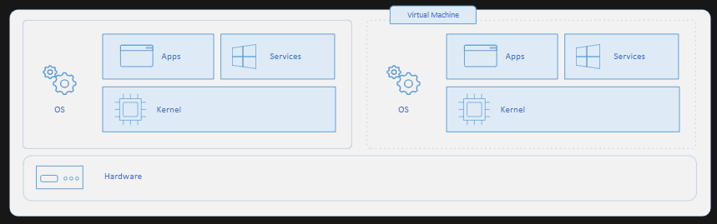
Containers vs. Virtual Machines

Slide 19
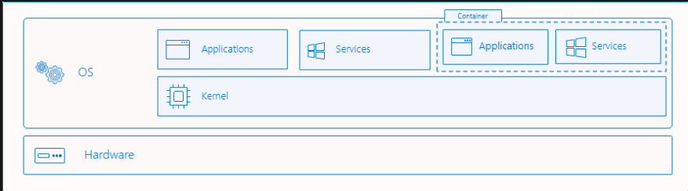
Process Isolation of Windows Containers

Slide 20
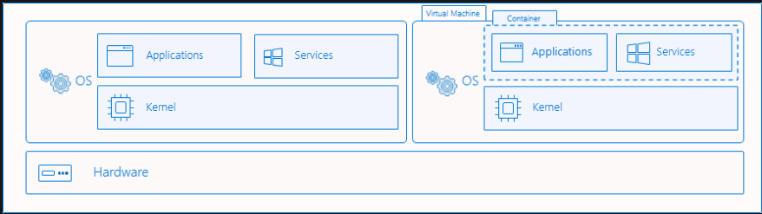
Hyper-V isolation

Slide 21
Docker Images and Containers
The Core Building Blocks

Slide 22
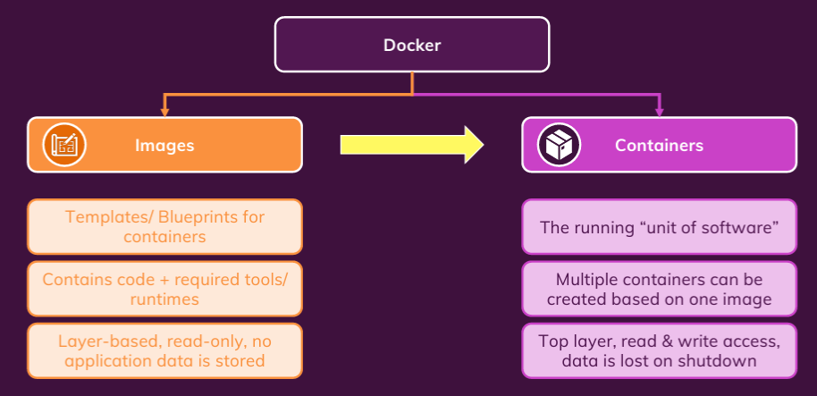
Images Vs Containers

Slide 23
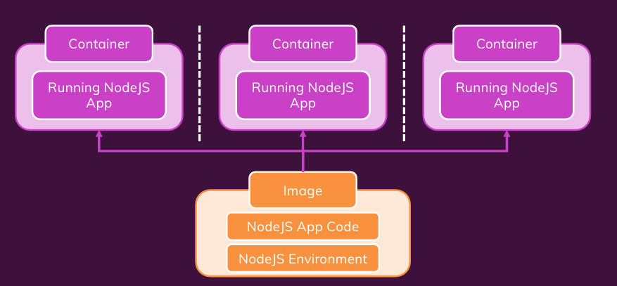
One Image, Multiple Containers

Slide 24
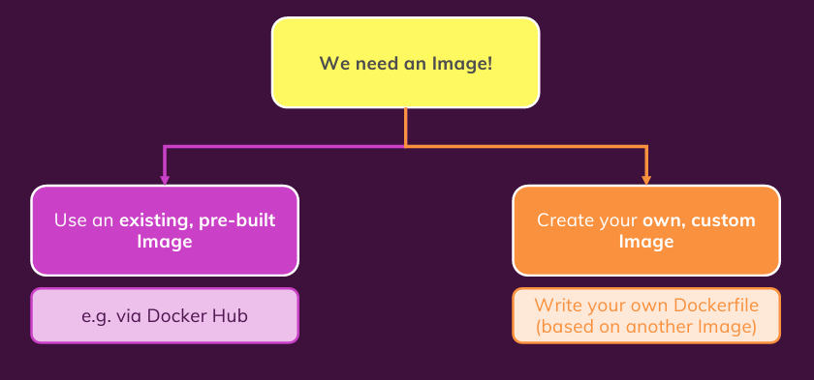
Finding/Creating Image

Slide 25
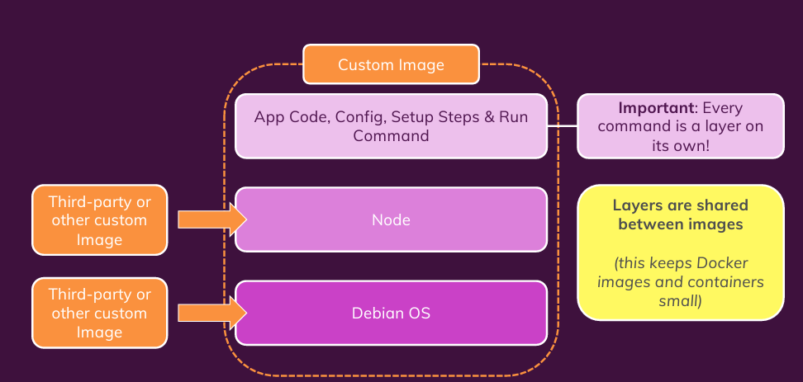
Image and Image Layers

Slide 26
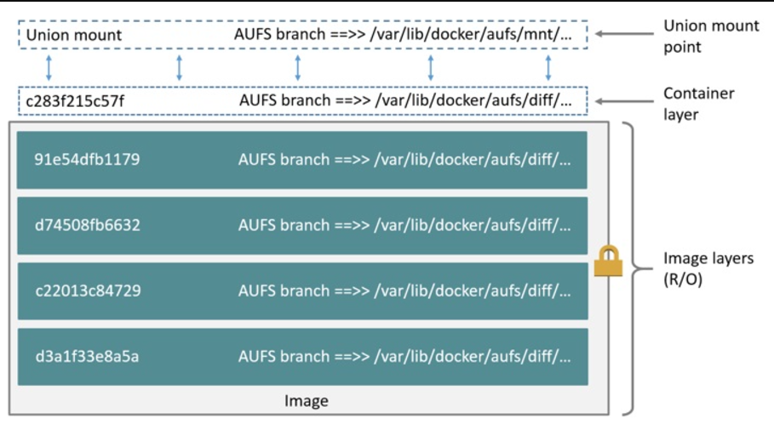
The OS Image layer (in container)

Slide 27
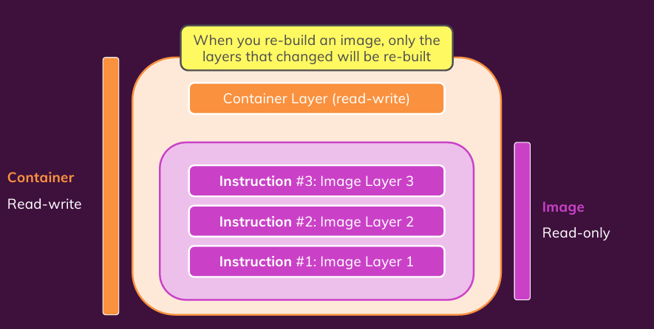
Container is Based on An Image

Slide 28
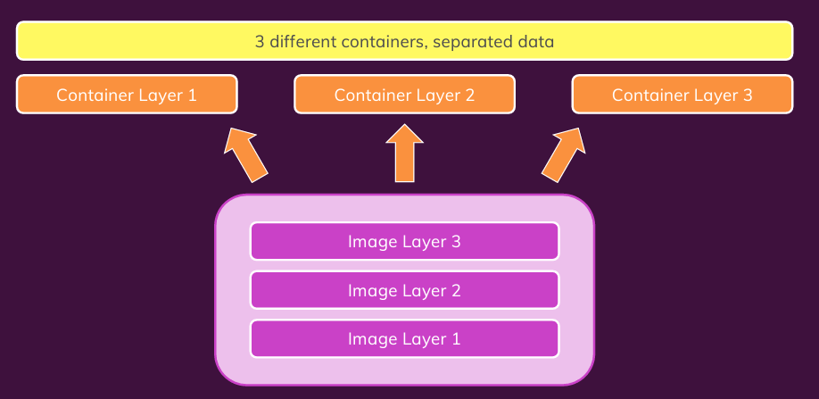
Multiple Containers Based on Same Image

Slide 29
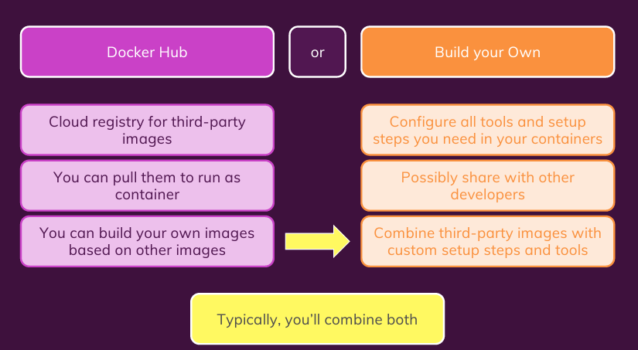
Where to Get Image

Slide 30
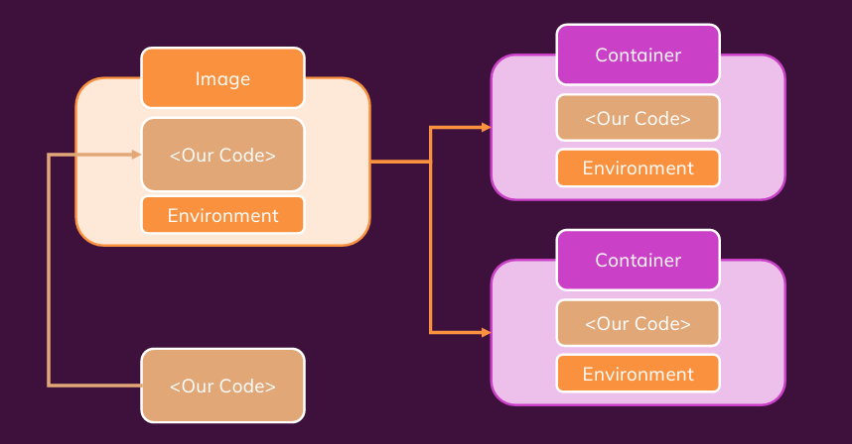
Summary

Slide 31
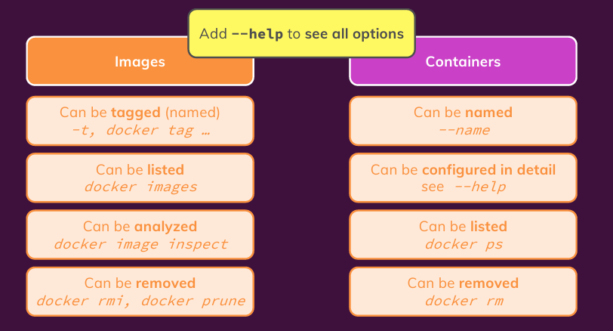
Managing Images and Containers

Slide 32
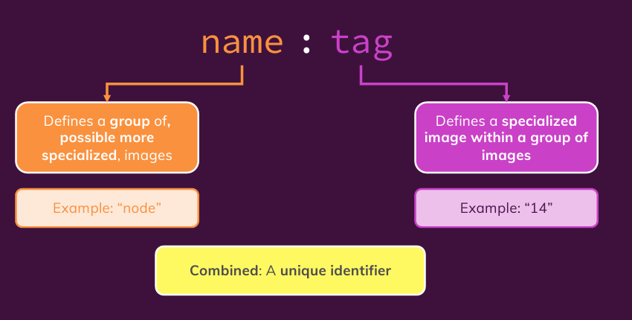
Image Tags

Slide 33
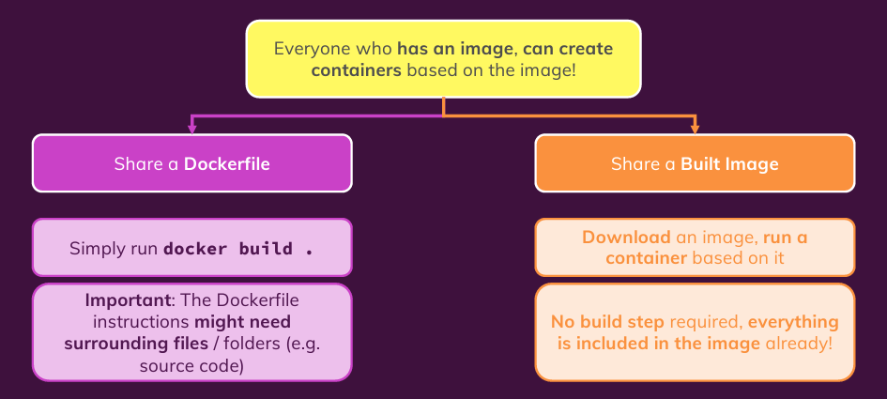
Sharing Image and Container

Slide 34
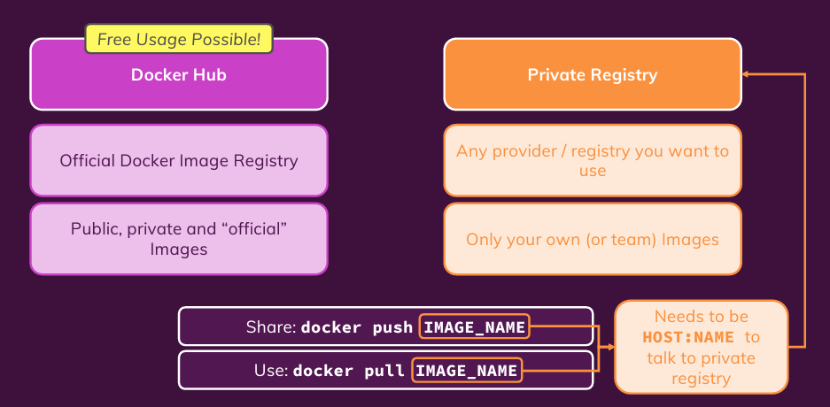
Sharing via Dicker Hub or Private Registry

Slide 35
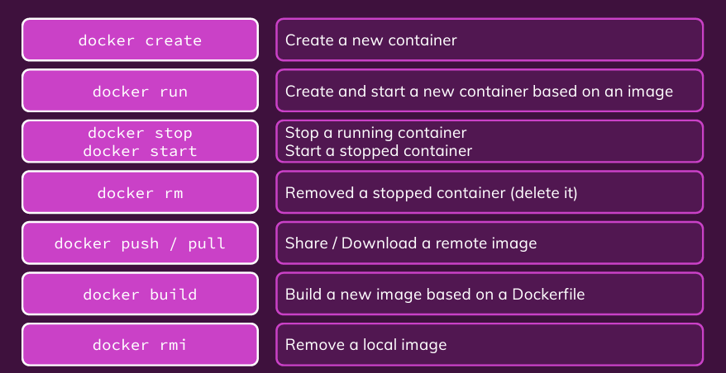
Key Commands

Slide 36
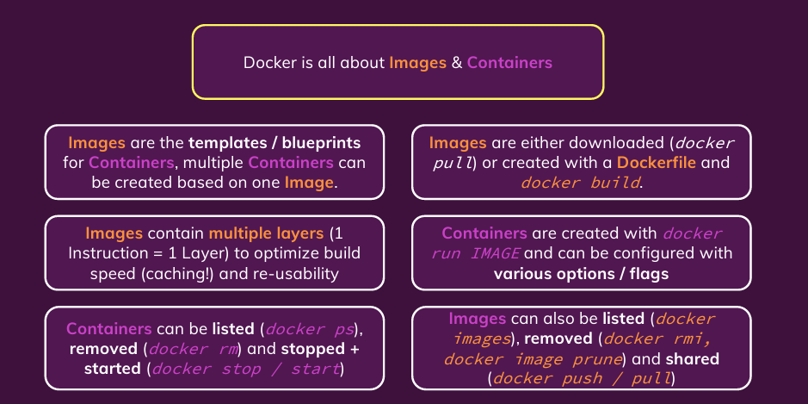
Summary

Slide 37
Data and Volumes
Managing data and working with volumes

Slide 38
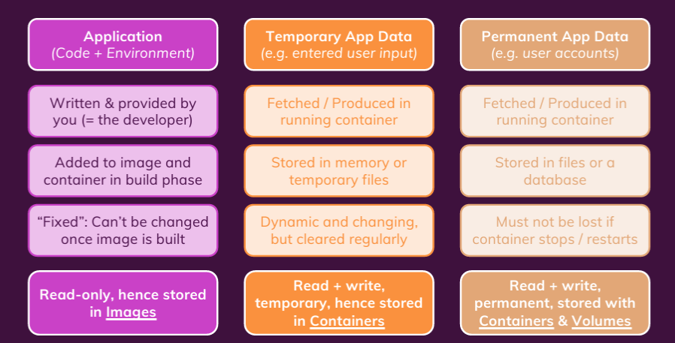
Data

Slide 39
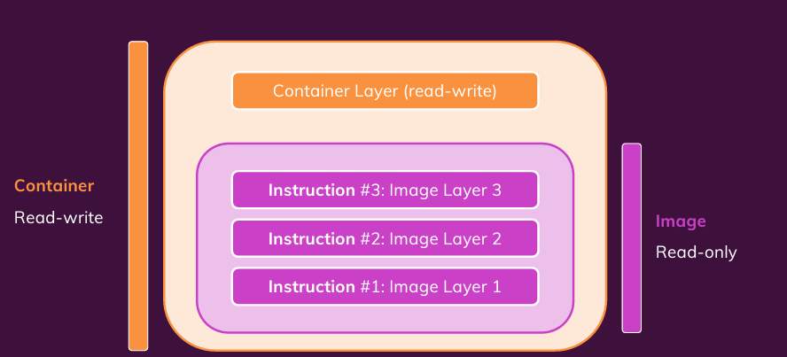
Container: Its Internal Storage

Slide 40
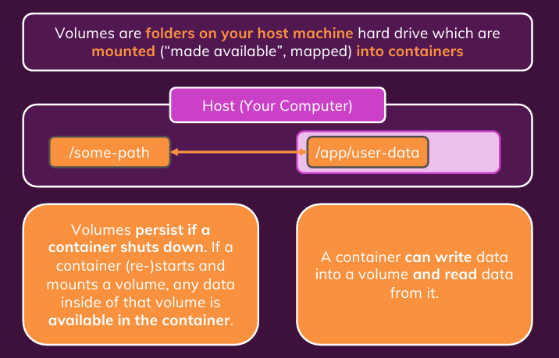
Understanding Volumes

Slide 41
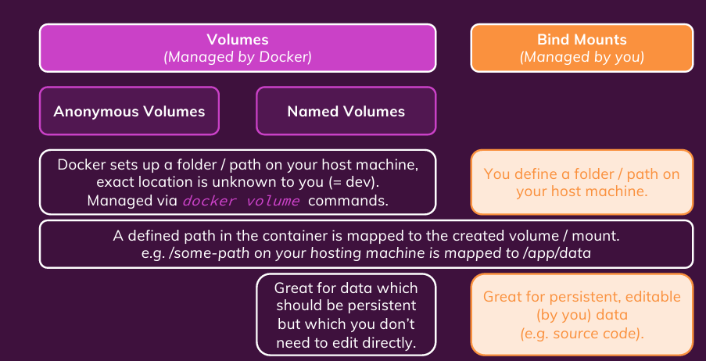
Types of External Data Storages

Slide 42
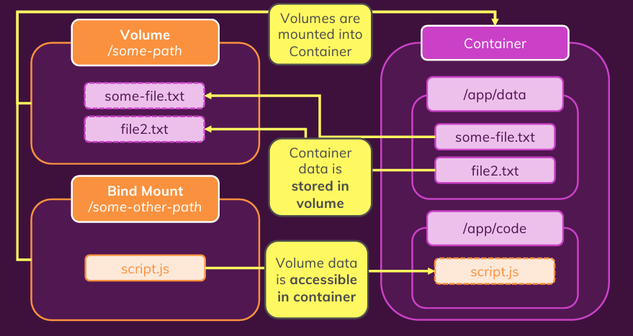
Understanding Volume/Container Interaction

Slide 43
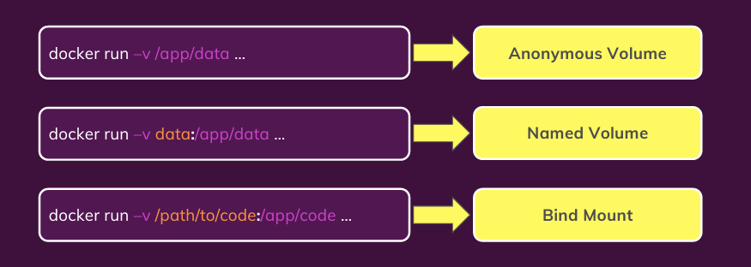
Volumes and Bind Mounts: Quick Look

Slide 44
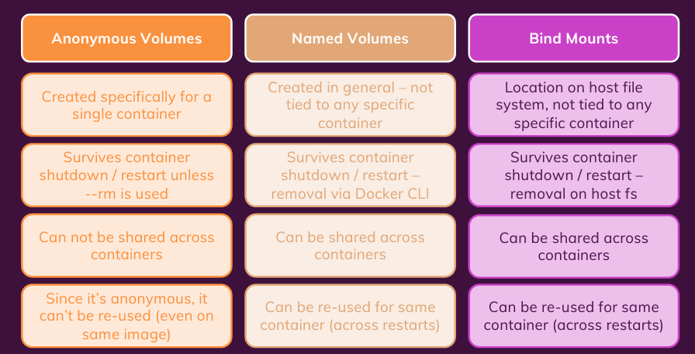
Volumes Comparison

Slide 45
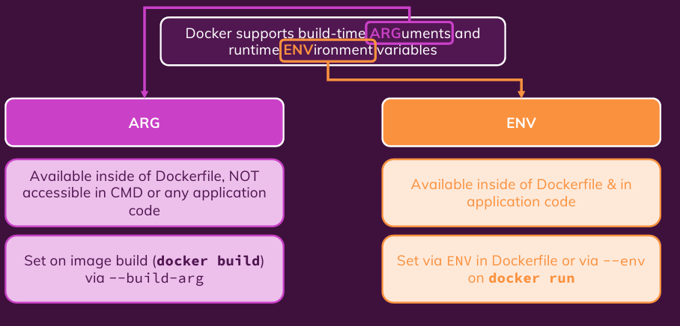
Arguments and Environment Variables

Slide 46
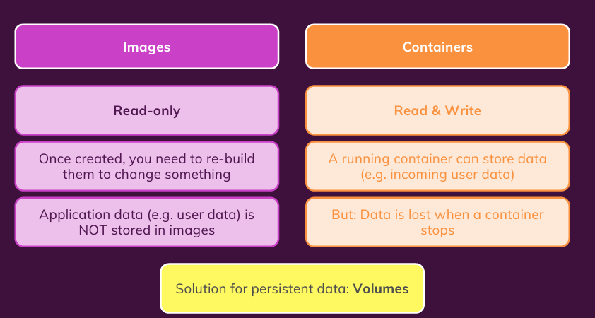
Read-only, Read-Write Volumes

Slide 47
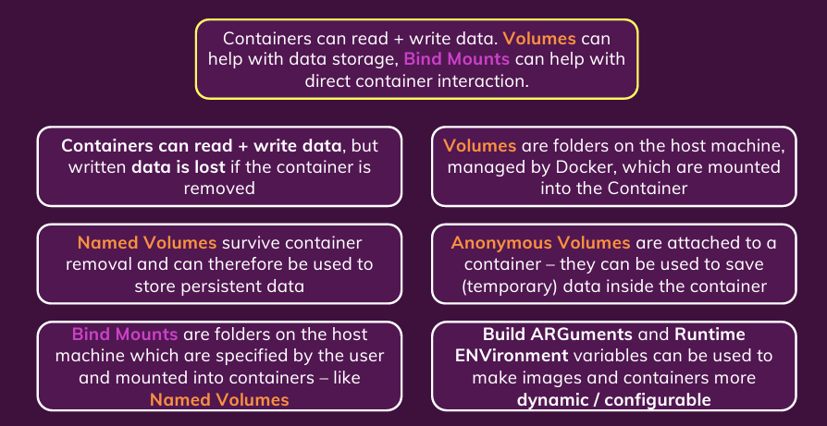
Summary

Slide 48
Networking in Docker
(Cross-) Container interaction/communication

Slide 49
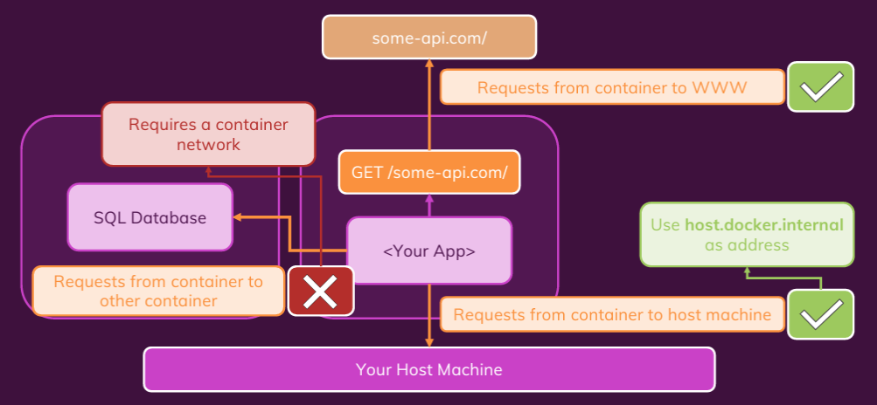
Containers and Network Requests

Slide 50
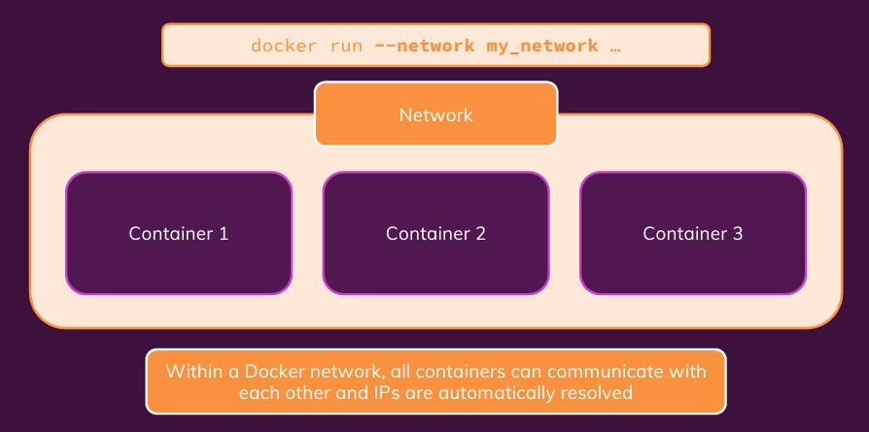
Creating Container Networks

Slide 51
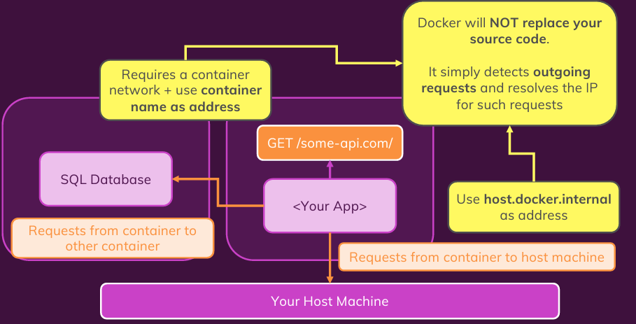
Understanding Docker Network IP Resolving

Slide 52
Multi-container Application with Docker
Multiple containers with different applications and services

Slide 53
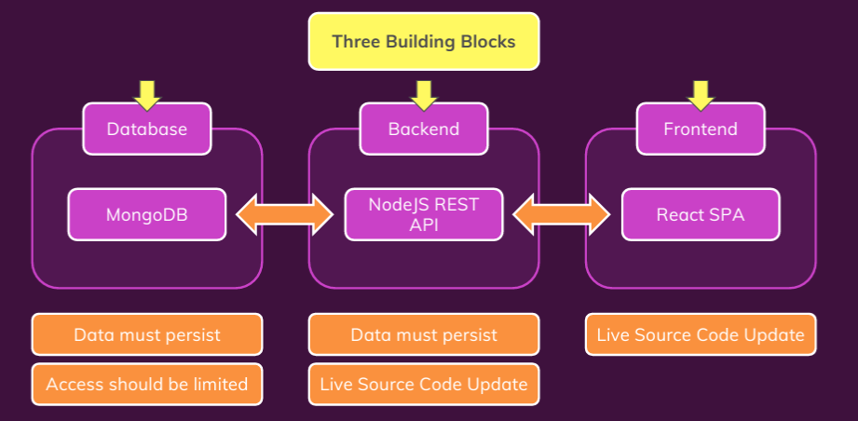
Demo

Slide 54
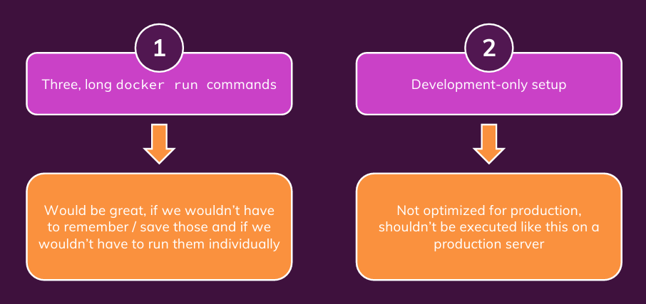
Issues

Slide 55
Docker Compose

Slide 56
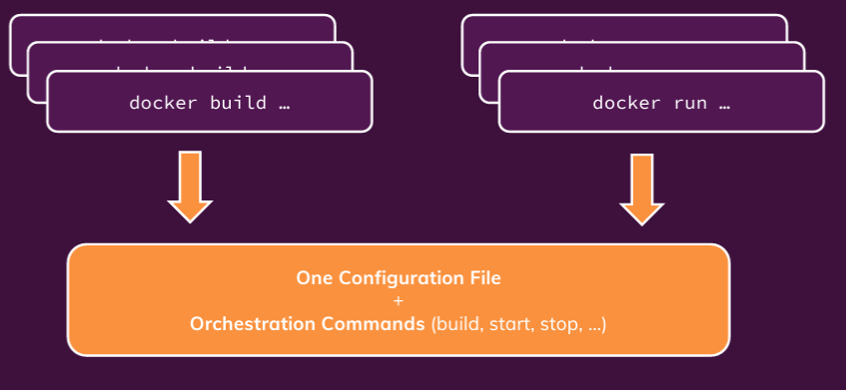
What is Docker Compose?

Slide 57

What Docker Compose Is Not?

Slide 58

Writing Docker Compose File

Slide 59
Kubernetes
Introduction to Kubernetes

Slide 60

Possible Problems with Docker

Slide 61

Solution (provided by AWS)

Slide 62

Problem with a Cloud Provider

Slide 63

Kubernetes to Your Rescue
Kubernetes is like Docker-Compose for multiple machines

Slide 64

Why Kubernetes?

Slide 65

Extensible, Yet Standardized Configuration

Slide 66

What Kubernetes is and is not

Slide 67

Kubernetes Architecture

Slide 68

How Worker Nodes Work

Slide 69

Core Kubernetes Concepts and Architecture
If some pods go down or for scaling up, some new pods need to be created. It tells the API server to pass instruction to worker nodes

Slide 70

Core Components of Kubernetes

Slide 71

Kubernetes ‘s and Developer’s Work

Slide 72
Using Kubernetes
Set-up and Deep Dive into Core Concepts

Slide 73

Kubectl

Slide 74

Kubernetes Objects

Slide 75

Pod Object

Slide 76

Deployment Object

Slide 77

Service Object

Slide 78

Behind the Scene

Slide 79

Imperative Vs. Declarative Usage

Slide 80

Resource Definition

Slide 81
Data and Volumes

Slide 82

Understanding “State”

Slide 83

Managing Volumes in Kubernetes

Slide 84

Kubernetes Volumes

Slide 85

K8s Volumes Vs Docker Volumes

Slide 86

Persisted Volumes

Slide 87

From Volumes to Persistent Volumes

Slide 88

Persistent Volumes and Persistent Volume Claims

Slide 89

Normal Volumes Vs. Persistent Volumes

Slide 90
Kubernetes Networking

Slide 91

Our App

Slide 92

Our App

Slide 93

Our App

